Slide 1
Lecture 8: Modeling Electrical Systems
determine the mathematical models that capture the behavior of an electrical system
Elements making up an electrical system
First-principles modeling of electrical systems in the time domain
Modeling in the Laplace domain (next time)

Slide 2
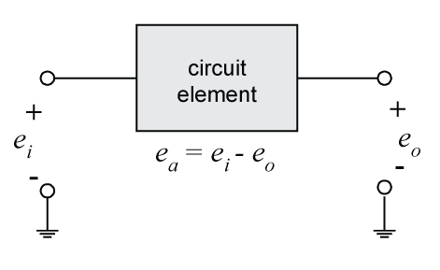
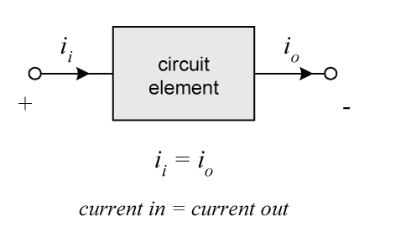
Modeling Electrical Systems
Voltage (e) – is a measure of the force that causes electrons to move through a circuit (a potential measured w.r.t. a ground)
Current (i) – is a measure of the rate of flow of charge (electrons) through a circuit (i=dq/dt), current has direction

Slide 3
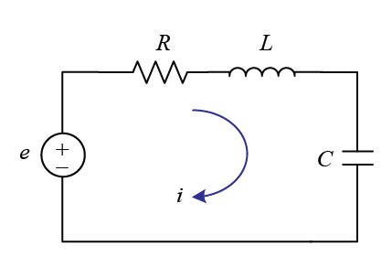
Modeling Electrical Systems
Electrical systems consist of three basic types of elements
Resistance elements
Capacitance elements
Inductance elements

Slide 4
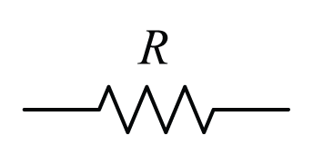
Modeling Electrical Systems
Resistance Elements
Dissipate energy (like a damper)
Resistance has units of an Ohm (Ω)

Slide 5
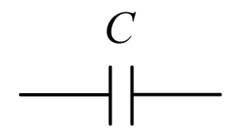
Modeling Electrical Systems
Capacitance Elements
Capacitance is measured as charge stored per unit voltage
If you apply a voltage across a capacitor a potential builds up that is then released if the voltage is removed … in other words, capacitors store potential energy (like a spring)
Capacitance has units of a Farad (F)
Notes:
A capacitor is constructed of two conductive plates separated by an insulating dielectric material … electrons build up on the negative side and are lost on the positive side
Capacitors store energy, like a battery, can be used in hybrid vehicles as another power source (ultra-capacitors)

Slide 6
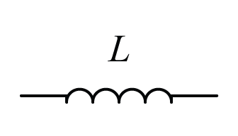
Modeling Electrical Systems
Inductance Elements
An inductor is a coil of wire such that current through the coil generates a magnetic field which induces a voltage that is proportional to how fast the current is changing
If power is disconnected, the induced voltage will make the current continue to flow (like an inertia)
Inductance elements store kinetic energy
Inductance has units of a Henry (H)

Slide 7
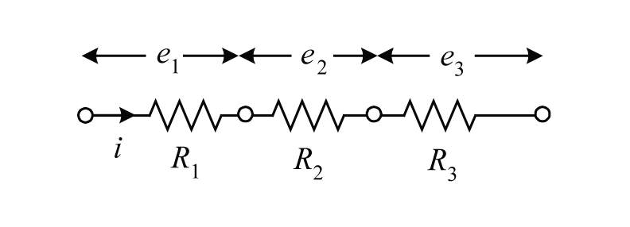
Electrical Circuits
Resistors in series

Slide 8
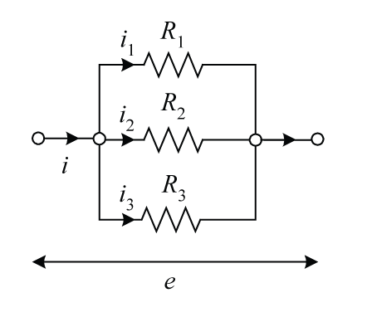
Electrical Circuits
Resistors in parallel
Notes:
Will be important for when we model circuits in the Laplace domain

Slide 9
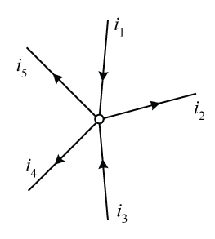
Electrical Circuits
Kirchoff’s Current Law (node law)
Current in to a node is conserved

Slide 10
Electrical Circuits
Kirchoff’s Voltage Law (loop law)
Sum of voltages around a loop equals zero

Slide 11
Electrical Circuits
Use one equation for each loop
Assume a direction for current, if solution is negative, know direction is opposite

Slide 12
Electrical Circuits
Equations can be rewritten in terms of charge q
A mechanical analog exists for each circuit
What are the state variables?
energy storage element state variable
capacitor
inductor

Slide 13
Electrical Circuits
Putting into state space form where e_{i} is the input and i₁ is the output

Slide 14
Electrical Circuits
Putting into matrix form

Slide 15
Example
Find the transfer function E_{o}(s)/E_{i}(s)
Notes:
Include units

Slide 16
Example (con’t)

